Slide 1
Jump and jive jelly beans
Members: Ahras, Kushagr, Philip and Yi

Slide 2
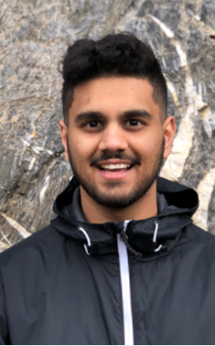
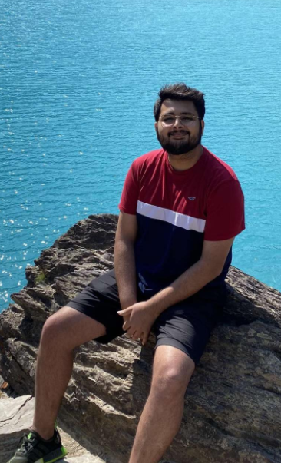
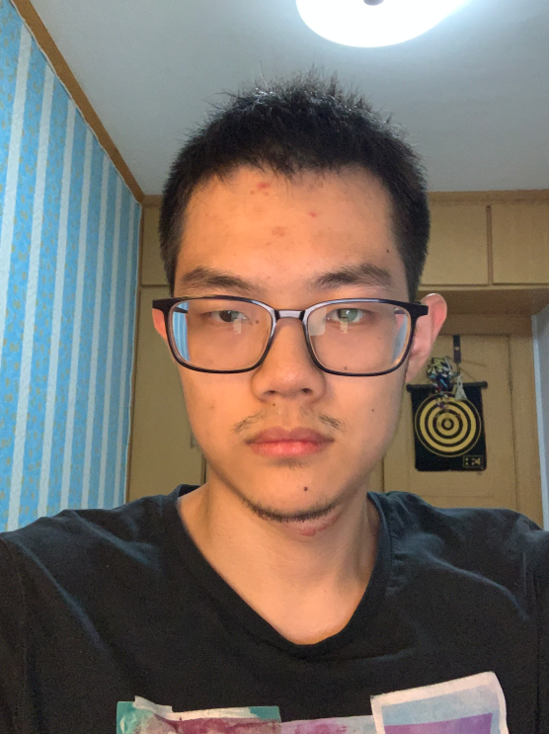
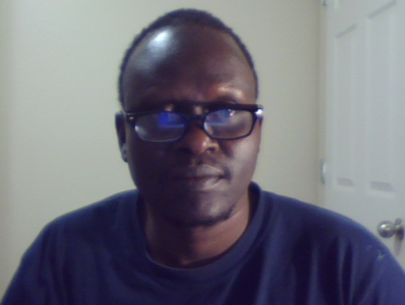
The team

Slide 3
Project requirements/ business opportunity
The accreditation in excel format is very concerning. The accreditation team at University of Regina Engineering department want the format to be changed into a simple technological format whereby the new professor could be able to perform with ease. It has been a long time since this document has been kept in the excel format. Some professors get confused when accredited classes because the information in excel format is so condensed. Our team has taken this opportunity to transform this accreditation excel format into a simple and easy use document. We want to break it down into filter it by class name, semester and GA. We also want to put the graduate attributes description into the attribute section so that the professor can go on it and review the graduate attribute. If we have enough time, we could be able to add a simple form that can be used by the professor to submit the class's graduate attributes.

Slide 4
North star customer/ empathy mapping
North star - Gina MacPherson.
Carryover Customer - Professors.
Gina is the one to collect graduate attributes from professors. She might be concerned if the data forward to her are not accurate. Also, she might be concerned if the data are not collected at all by the new professor. By making this document clear to the user (The Professor) that would make her job easy. She may be able to collect the correct data from professors with accuracy. Professors on the other hand may use this app to check the graduate attributes and collect the classes graduate attributes base on what is indicated on each class’s required GA.

Slide 5
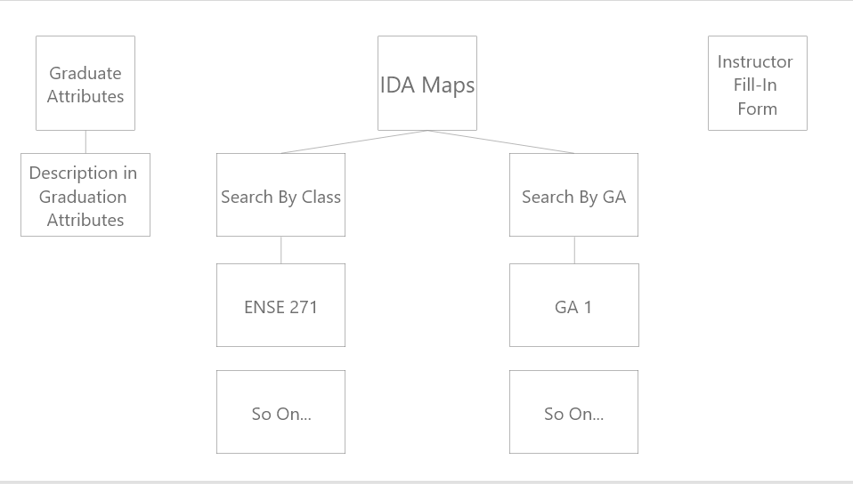
Affinity Diagramming

Slide 6
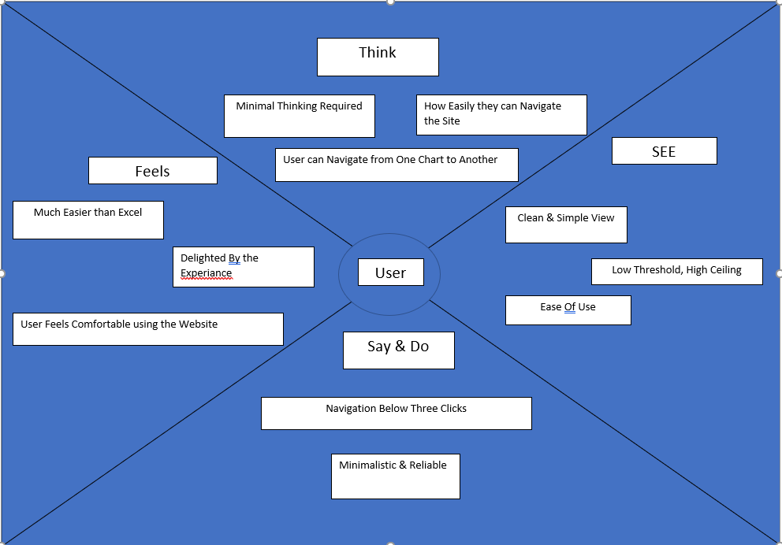
Empathy mapping

Slide 7
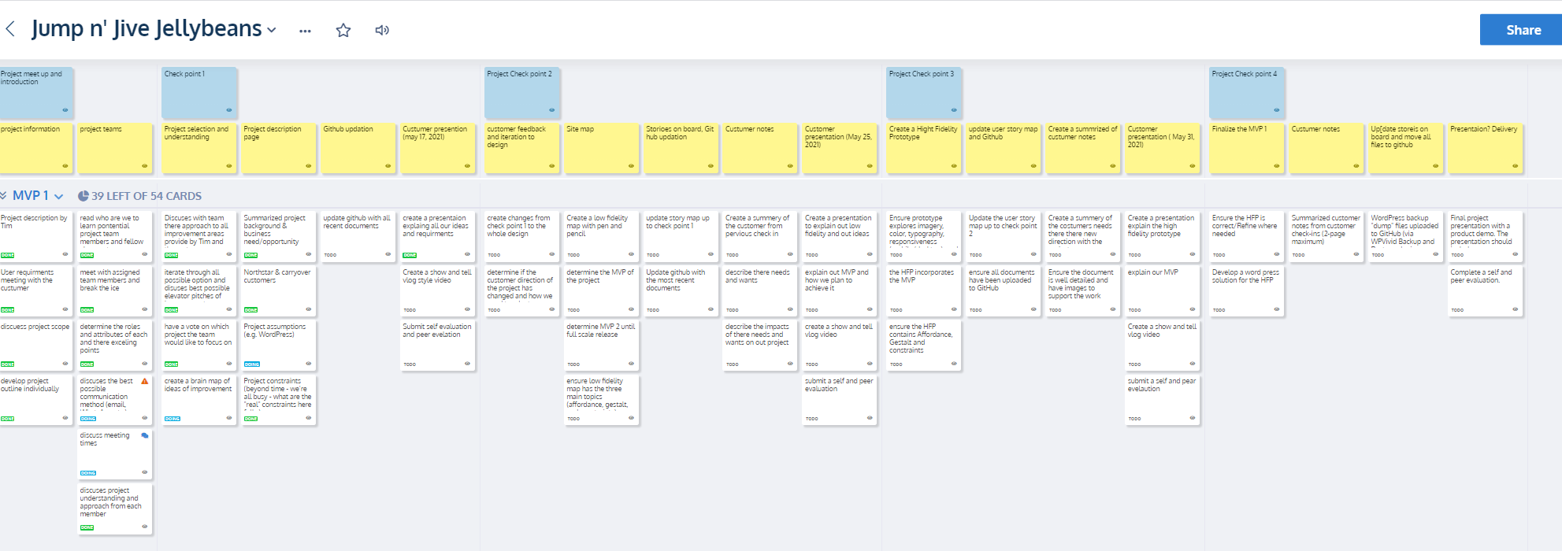
https://landofooo.storiesonboard.com/m/jump-n-jive-jellybeans

Slide 8

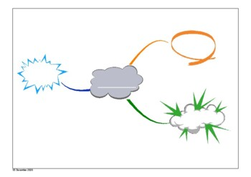

Project name conversion
-Jump and jive jelly beans was a hand full to say
- Map minds represents the purpose of the project
Map Minds

Slide 9


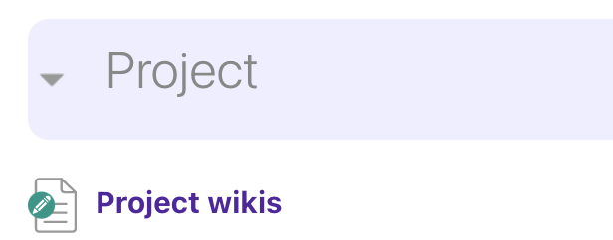
Project Document locations
GitHub:
https://github.com/JumpLiveJellyBeans/ENSE-271-Project
Project Description:
UR Courses/ Project Wiki page

Slide 10
Project constraints
Project constraints:
learning the application as the class progresses limits application possibilities
We limited the scope of the project to achieve the best possible outcome (more focused approach)
Team cohesion:
Having a tough time figuring out available times for the whole team
Time differences and location difference, the whole team is disbursed
All members of the team have 2 or more classes with a backed schedule
Next week we have long weekend so we are expecting some sort of delay
We don't have a platform of constant communication

Slide 11

Customer feedback and Project direction

